Slide 1
RATP DATASET
Saffian Asghar
Emilio Espinosa Sanchez

Slide 2
WORKFLOW
EDA
Analyze the data, filter significant attributes, substitute missing values
NORMALIZE DATA
Scale the data
MODEL
Select and build suitable models depending upon your data
COMPARISON AND REGRESSION
Train your model and test it with an unseen sample.
Compare different models results and accuracy

Slide 3

EDA
Variables to analyze air quality:
Weather parameters:
Humidity (HUMI).
Temperature (TEMP).
Air renewal:
Carbon dioxide (CO2).
Quality of air:
Nitrogen oxide (NO, NO10).
Particles (PM10, PM2.5).

Slide 4
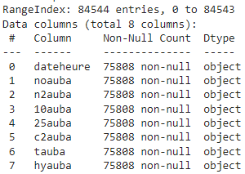
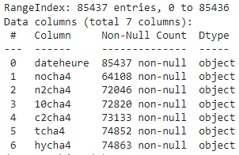
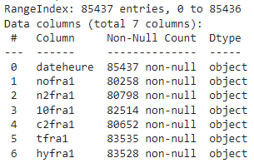
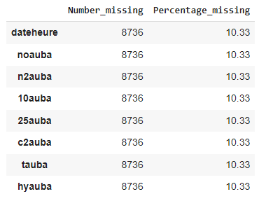
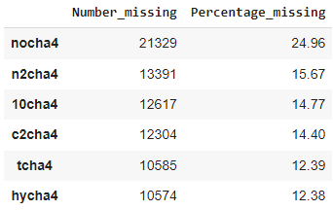
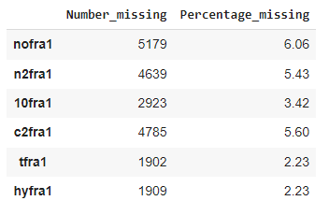
EDA
AUBER
CHATELET
FRANKLIN

Slide 5
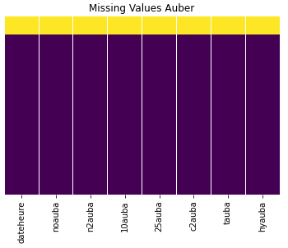
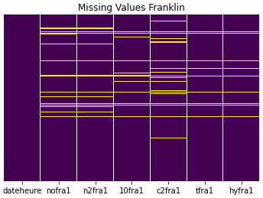
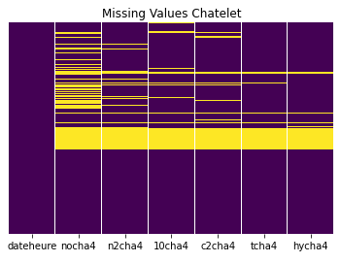
EDA
AUBER
FRANKLIN
CHATELET

Slide 6
EDA
Replacement of “,” for “.”
Replacement of “ND” values for None.
Take out “>” and “<” signs.
Convert columns to numeric format.
Date/Time column to date time format.
Drop rows with more than one missing value.
Replace rest of missing values with the mean grouped by date and time.

Slide 7
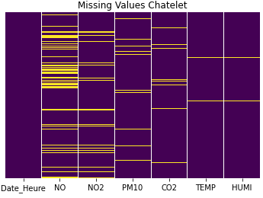
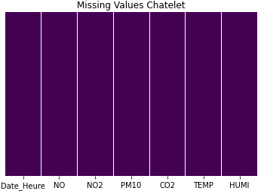

EDA

Slide 8
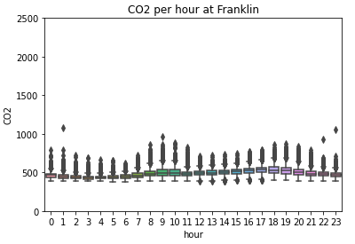
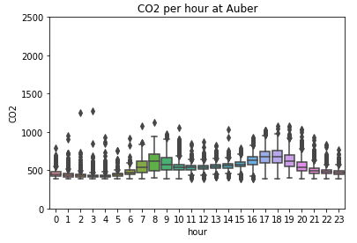
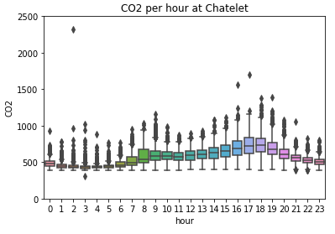
EDA
Divide date/time value in: weekday, month, year and hour.

Slide 9
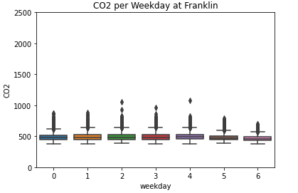
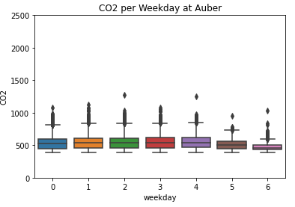
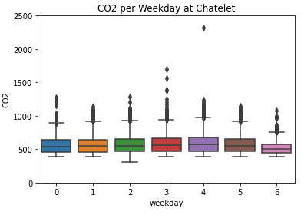
EDA

Slide 10
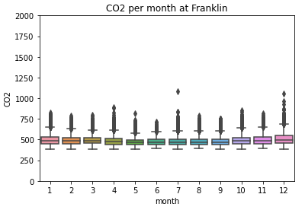
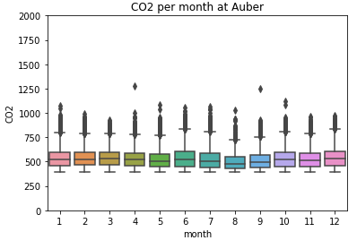
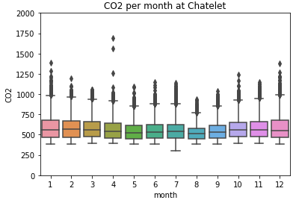
EDA

Slide 11
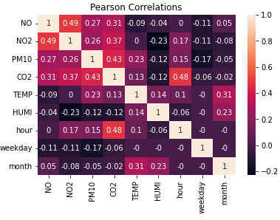
EDA-CORRELATIONS
CHATELET

Slide 12
Predict CO2

Slide 13
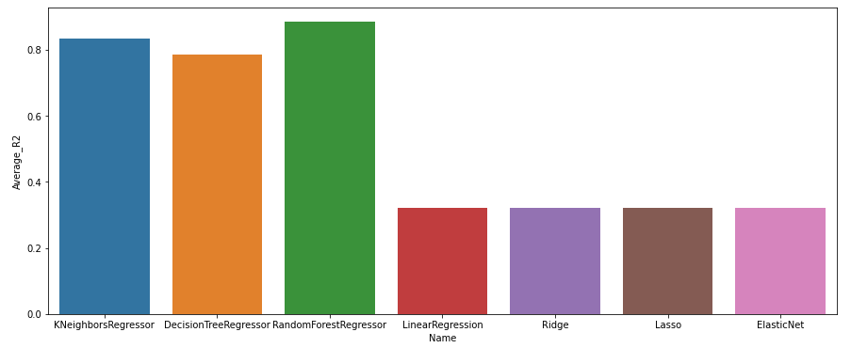
Comparison Table by R-square
PARAMETER | K Neighbor regressor | Decision Trees | Random Forest | Linear Regression | Ridge | Lasso | Elac. Net
Chatelet R–square | 0.834 | 0.785 | 0.884 | 0.320 | 0.320 | 0.320 | 0.319
Notes:
# Accuracy: how good we were in recognizing positive and negative
# Precision: how correct the classifier is
# Recall: how complete the classifier is
# F-Score: combination of presition and recall

Slide 14
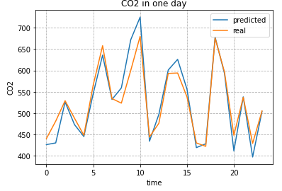
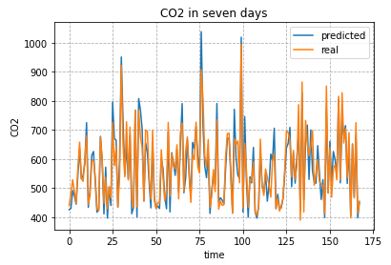

Slide 15
Predict NO, NO2 and PM10

Slide 16
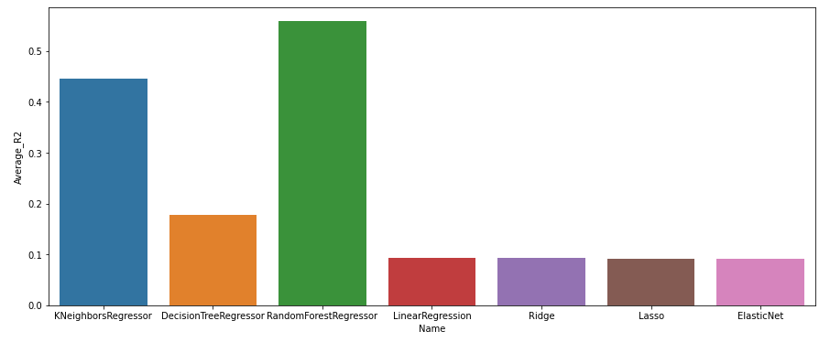
Comparison Table by R-square - NO
PARAMETER | K Neighbor regressor | Decision Trees | Random Forest | Linear Regression | Ridge | Lasso | Elac. Net
Chatelet R–square | 0.445 | 0.178 | 0.558 | 0.092 | 0.092 | 0.091 | 0.091
Notes:
# Accuracy: how good we were in recognizing positive and negative
# Precision: how correct the classifier is
# Recall: how complete the classifier is
# F-Score: combination of presition and recall

Slide 17
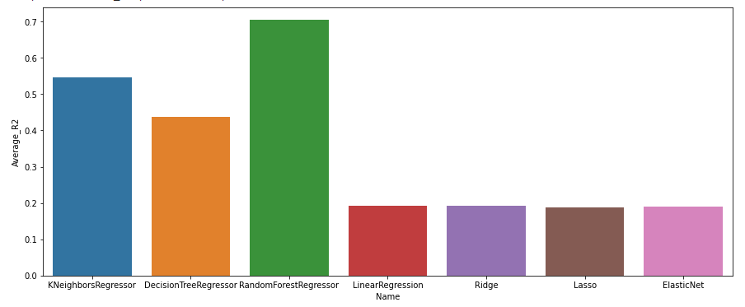
Comparison Table by R-square - NO2
PARAMETER | K Neighbor regressor | Decision Trees | Random Forest | Linear Regression | Ridge | Lasso | Elac. Net
Chatelet R–square | 0.484 | 0.190 | 0.578 | 0.204 | 0.204 | 0.204 | 0.203
Notes:
# Accuracy: how good we were in recognizing positive and negative
# Precision: how correct the classifier is
# Recall: how complete the classifier is
# F-Score: combination of presition and recall

Slide 18
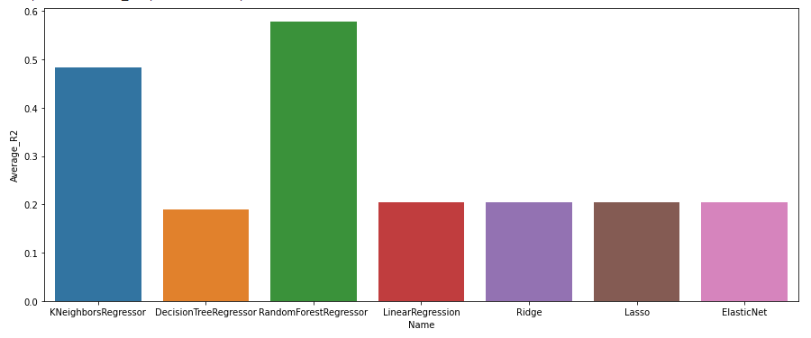
Comparison Table by R-square - PM10
PARAMETER | K Neighbor regressor | Decision Trees | Random Forest | Linear Regression | Ridge | Lasso | Elac. Net
Chatelet R–square | 0.484 | 0.190 | 0.578 | 0.204 | 0.204 | 0.204 | 0.204
Notes:
# Accuracy: how good we were in recognizing positive and negative
# Precision: how correct the classifier is
# Recall: how complete the classifier is
# F-Score: combination of presition and recall

Slide 19
COMPARISON CO2

Slide 20
Comparison Table by R-square - CO2
PARAMETER | K Neighbor regressor | Decision Trees | Random Forest | Linear Regression | Ridge | Lasso | Elac. Net
Chatelet | 0.484 | 0.190 | 0.578 | 0.204 | 0.204 | 0.204 | 0.204
Franklin | 0.614 | 0.542 | 0.757 | 0.185 | 0.185 | 0.186 | 0.185
Auber | 0.786 | 0.696 | 0.840 | 0.180 | 0.180 | 0.180 | 0.179
Notes:
# Accuracy: how good we were in recognizing positive and negative
# Precision: how correct the classifier is
# Recall: how complete the classifier is
# F-Score: combination of presition and recall

Slide 21
MODEL REPLICATION

Slide 22
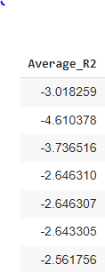
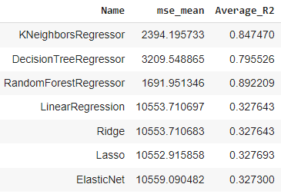
Results of comparison
Same station
Model trained on one station and tested on another
Notes:
# Accuracy: how good we were in recognizing positive and negative
# Precision: how correct the classifier is
# Recall: how complete the classifier is
# F-Score: combination of presition and recall

Slide 23
THANK YOU
Saffian
Emilio

